Slide 1

MUTATION NETWORK TOOL
Lee Potashnik
Pablo Dobrzynski
Supervisor:
Dr. Zakharia Frenkel
GitHub

Slide 2

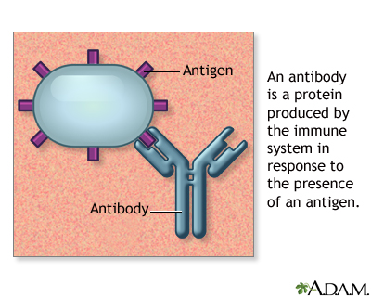

Background
When infection occurs, B cells multiply and produce antibodies.
Through Somatic Hypermutation, mutations appear in variable antibody regions.
Antigens are molecules that trigger an immune response. Antibodies bind to antigens to neutralize them.
B cells with strongest-binding antibodies survive via positive selection.
This creates a non-uniform distribution of antibody sequences: Some triplets appear frequently while others become rare or disappear.
Sequence distribution reflects immune capability and is influenced by health, age, vaccinations, and exposure history.
Notes:
When our body faces an infection, a special type of immune cell called B cells starts to multiply and produce antibodies. These antibodies are proteins that help us recognize and neutralize germs like viruses and bacteria. During this process, B cells undergo small changes, called somatic mutations, to make the antibodies even better at binding to these germs. This leads to some antibodies being more common because they’re more effective, while others become less common. In simple terms, the pattern of these antibodies in our body can tell us a lot about our immune health, our age, our vaccination history, and what kind of infections we’ve been exposed to.

Slide 3
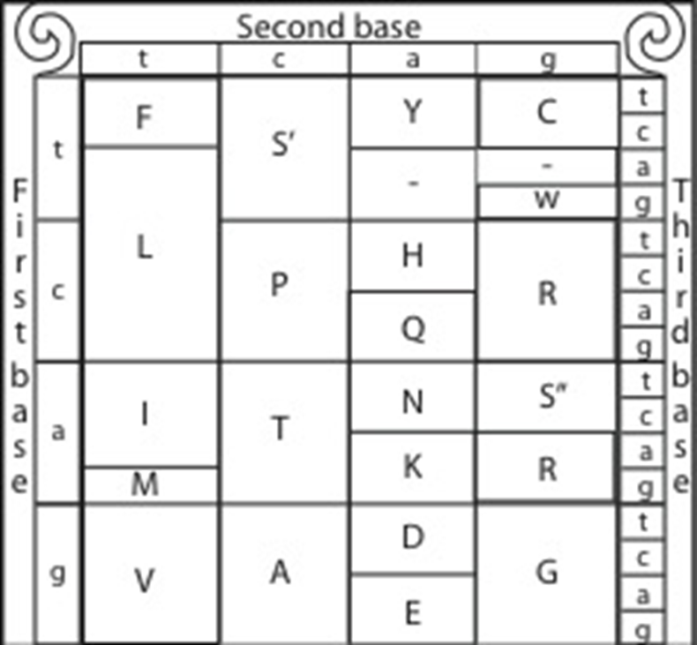
Research Foundation
Proteins are made of amino acids, each encoded by a DNA triplet (codon) via the genetic code
Antibodies are immune system proteins with variable and conserved regions (CDRs & FWRs)
CDRs are responsible for binding to antigens and are highly variable
FWRs maintain the antibody structure and are more conserved
Understanding triplet variation at the amino acid level reveals differences in immune response
Notes:
Proteins are made of building blocks called amino acids. Each amino acid comes from a set of three DNA letters, called a codon. Antibodies, which help our immune system fight germs, have parts that can change a lot and parts that stay mostly the same. The changing parts help the antibody grab onto germs, while the stable parts keep the antibody’s shape. By studying these changes in amino acids, we can see why different people’s immune systems respond differently

Slide 4

Motivation
Understanding how antibody diversity develops, not just what the final sequences look like
Focusing on the process can help reveal hidden patterns and guide new insights into immune behavior
Notes:
We want to look at small local patterns in antibody sequences, not just the whole long sequences.
By focusing on short triplets, we can see small differences and hidden relationships between antibody groups.
This helps us better understand how the immune system works and how antibodies evolve and respond.

Slide 5

Existing Tools
Traditional tools rely on full-sequence alignment and miss local variation
PROSTAlign uses deep learning embeddings to align remote protein sequences
No existing tool visualizes triplet similarity networks or group-level profiles

Slide 6

Target Audience
Immunologists studying antibody variability and immune responses
Bioinformaticians looking for tools for protein sequence analysis
Researchers comparing disease, vaccination, or age-related immune profiles
Educators and students needing intuitive visualizations of protein similarity

Slide 7


Process
General Network Construction
Network Population
Network Comparison

Slide 8
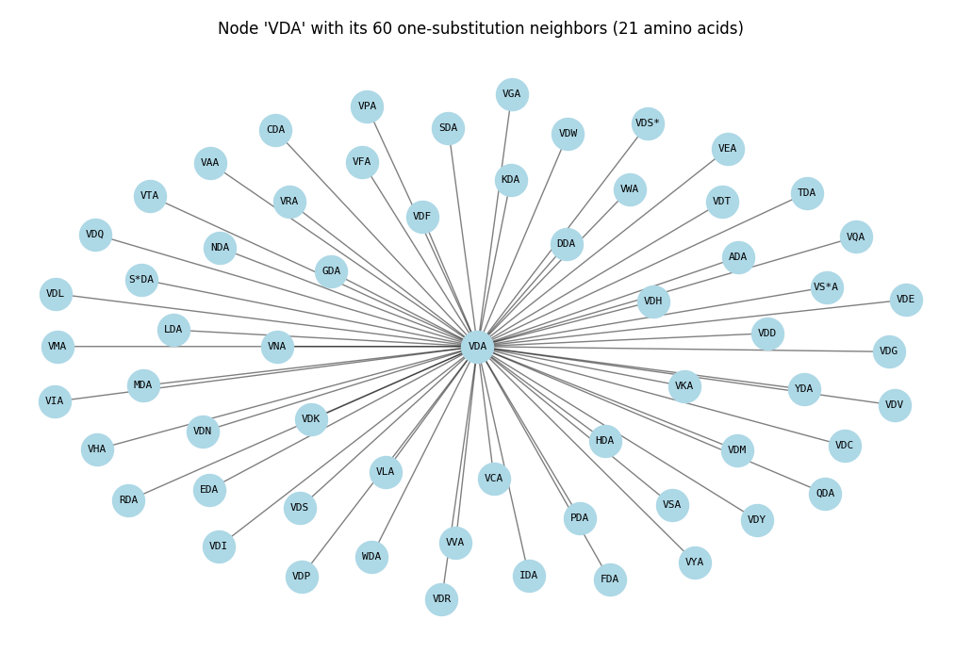
General Network Construction
Each node represents an amino acid triplet. There are 21 amino acids, will give us 9261 triplets. Up to 60 edges per node represent all possible single-position substitutions.

Slide 9

Network Population
Nucleotide sequences are loaded from the dataset and translated into amino acids, split into triplets, and each triplet's frequency is counted and mapped to the corresponding node. Each triplet will be saved with it’s dataset details.
AAACTGGTCGTAGACGCTACTTAGGTGTAGACGCTGGGCAGCTCGTAGACGCTGGGTGTTATACGCGACCATATGACCTCTGATCCAAGTAGACGCTTGT

Slide 10
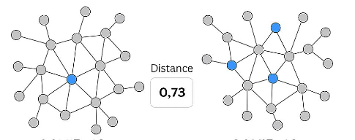
Network Comparison
Compare two networks (e.g., CDR1 vs. CDR3 or same region across populations) using a network comparison algorithm to detect structural and frequency-based differences.

Slide 11
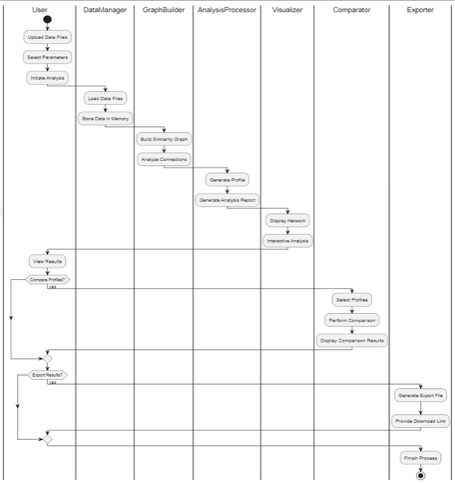
Activity Diagram
User initiates the process by uploading data
DataManager loads antibody sequences and metadata
GraphBuilder constructs similarity network from extracted triplets
AnalysisProcessor generates group profiles and statistics
Visualizer displays the graph and interaction options
Comparator compares profiles across groups
Exporter allows download of profile data and results

Slide 12
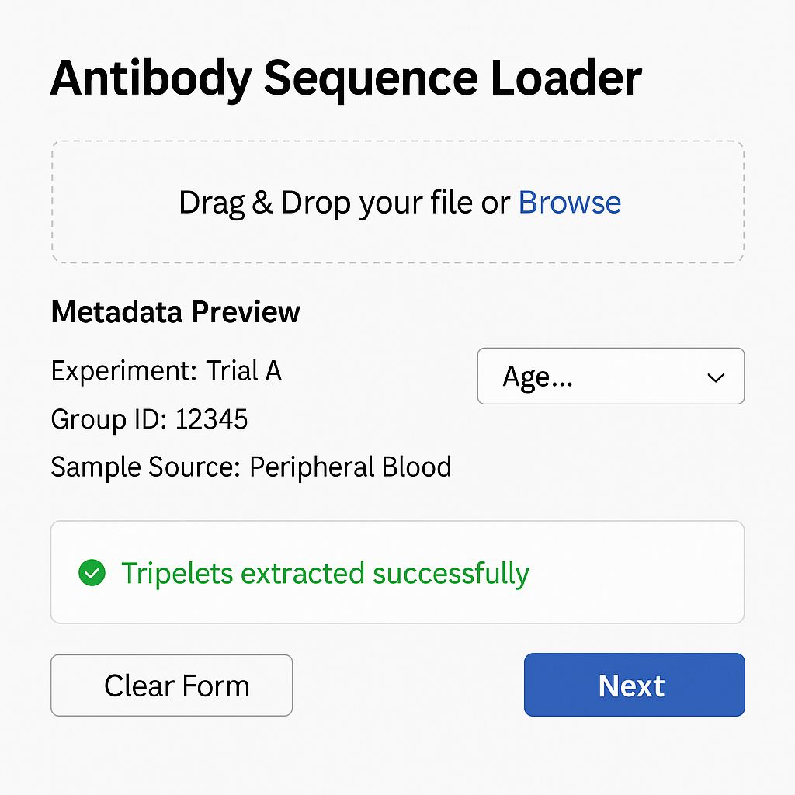
User Interface- Sequence Loader
Upload section allows users to drag & drop or browse for a sequence file
Metadata Preview summarizes key experimental context.
Dropdown to annotate demographic info
A success message indicates the data is ready for the next processing step

Slide 13
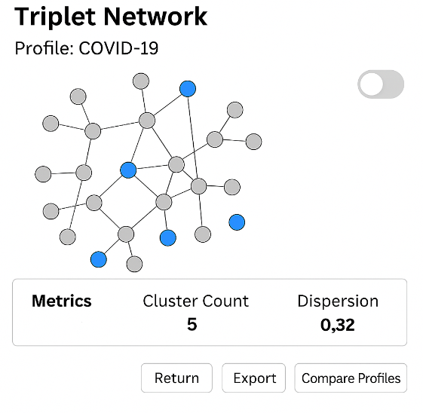
User Interface- Triplet Network
Visualize triplet similarity as a graph: Nodes = triplets, Edges = similarity relationships
Metrics: cluster count, dispersion
Toggle between amino acid and nucleotide views

Slide 14
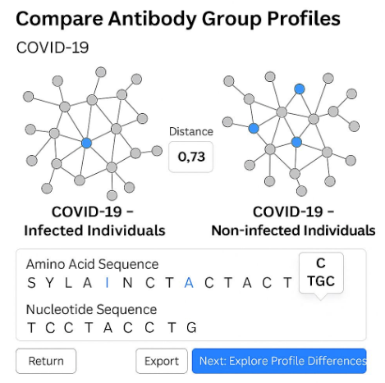
User Interface- Profile Comparison
Compare two antibody populations side by side
View their triplet similarity networks and a calculated Distance Score
Explore aligned sequences and see original codons for each amino acid
Enables intuitive, detailed comparison between immune profiles

Slide 15

Verification Plan – Testing Highlights
Validate sequence file upload and metadata parsing
Confirm correct triplet extraction from sequences
Test visualization loading under large data input
Check Distance Score calculation with both full and empty graphs

Slide 16

Expected Achievements
Provide researchers with a simple, intuitive tool to explore immune diversity
Represent antibody groups as triplet-based networks instead of raw sequences
Enable easy comparison between different populations (vaccinated, age groups)
Reveal local differences that standard tools may miss
Transform raw sequence data into clear, visual, and informative immune profiles

Slide 17
THANK YOU!

